Slide 1
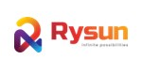
Payment Integration with Spring boot using Razorpay
- Hetasvi Ahir

Slide 2
Index
Introduction to Razorpay
Features of Razorpay
Working flow of Razorpay
Steps to create account in RazorPay
Steps to Integrate Razorpay with Spring boot

Slide 3
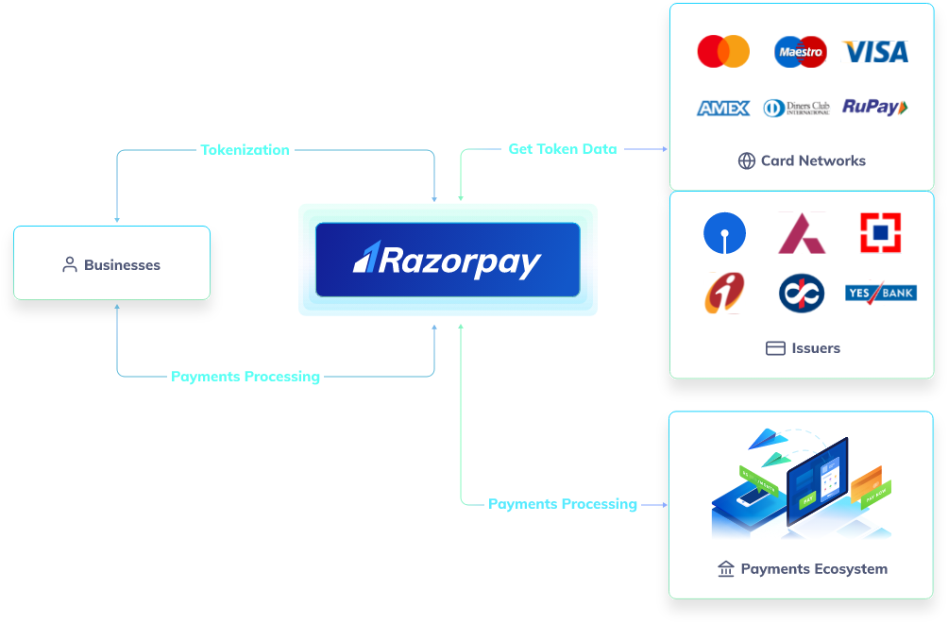
Introduction
RazorpayX supercharges your business banking experience, bringing effectiveness, efficiency, and excellence to all financial processes.
With RazorpayX, businesses can get access to fully-functional current accounts, supercharge their payouts and automate payroll compliance.
Fast forward your business with Razorpay.

Slide 4
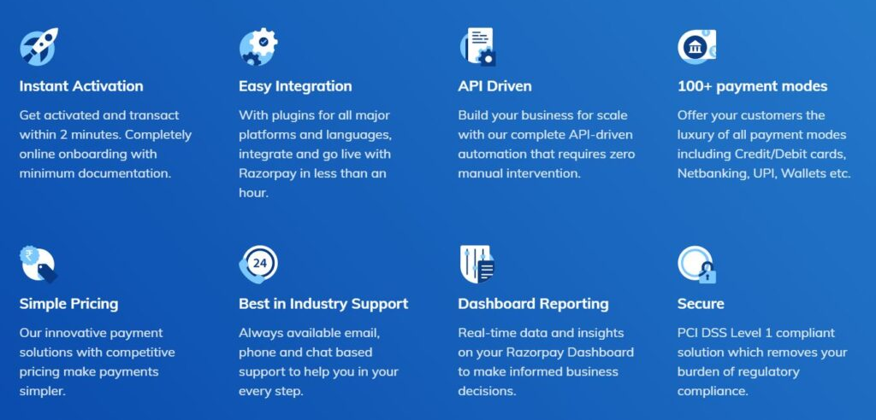
Features

Slide 5
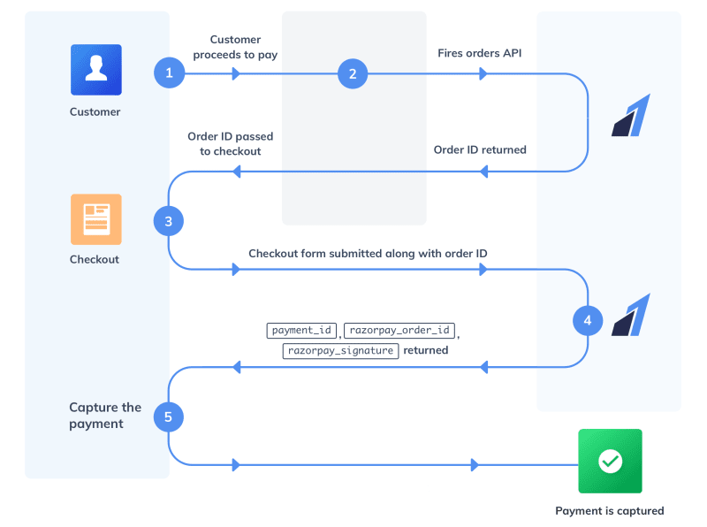
Workflow

Slide 6
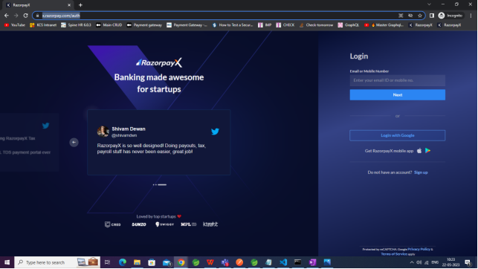
Steps to create Razorpay Account
Step 1 : Go to https://x.razorpay.com/auth
Step 2 : Click on Sign up to create new Account .

Slide 7
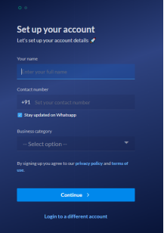

Steps to create Razorpay Account
Step 3 : Enter necessary Information .

Slide 8
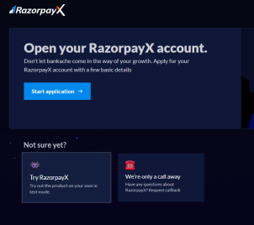
Steps to create Razorpay Account
Step 4 : After successful Account creation you will be redirected to Dashboard. Now select Try RazorpayX [Test Mode]

Slide 9
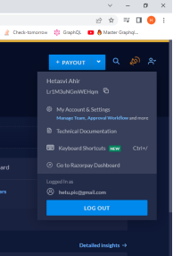
Steps to create Razorpay Account
Step 5 : Click on the profile icon , Which will open a dropdown menu . Go to My accounts and Settings.

Slide 10
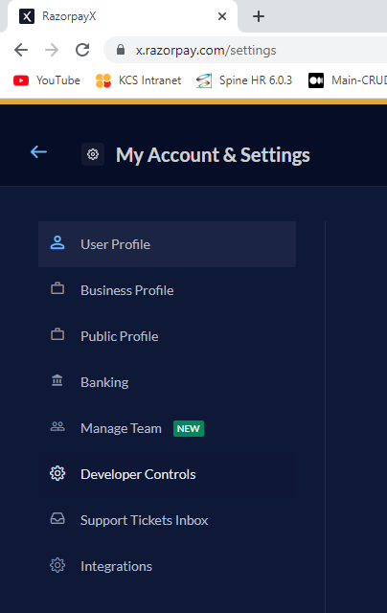
Steps to create Razorpay Account
Step 6 : Go to Developer Controls

Slide 11
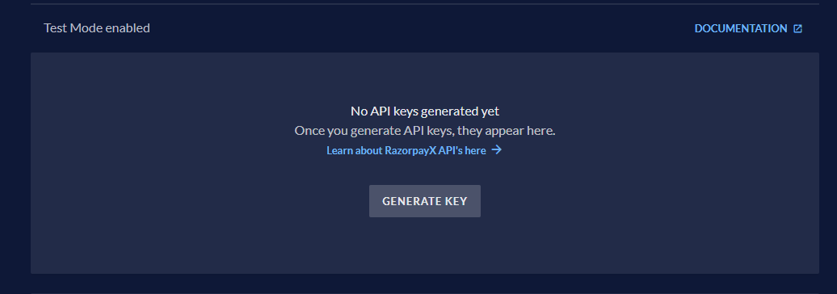
Steps to create Razorpay Account
Step 7 : Generate Key for Test mode .

Slide 12
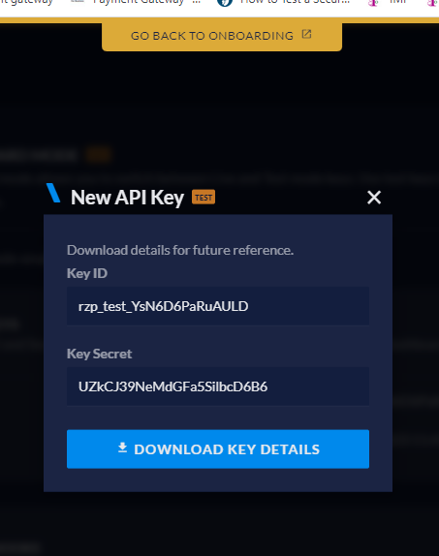
Steps to create Razorpay Account
Step 8 : Download Key details.

Slide 13
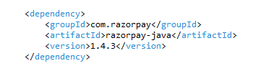
Steps to Integrate with Spring boot
Step 9 : Add RazorPay dependency .

Slide 14
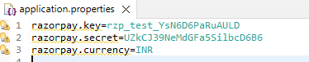
Steps to Integrate with Spring boot
Step 10 : Add following properties in application.properties.

Slide 15
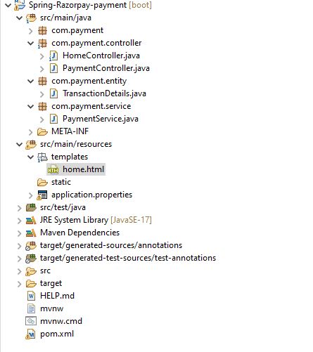
Steps to Integrate with Spring boot
Step 11 : Create one home.html file to redirect it to the checkout of payment of Razorpay and handle failure and success of the payment .

Slide 16
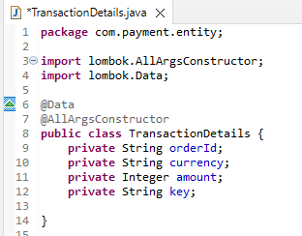
Steps to Integrate with Spring boot
Step 12 : Create one DTO TransactionDetails .

Slide 17
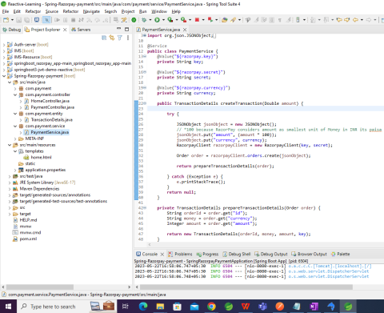
Steps to Integrate with Spring boot
Step 13 : Create Payment Service to create Razorpay client and create an order.

Slide 18
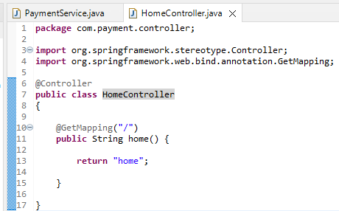
Steps to Integrate with Spring boot
Step 14 : Create one Controller to access the home.html page .

Slide 19
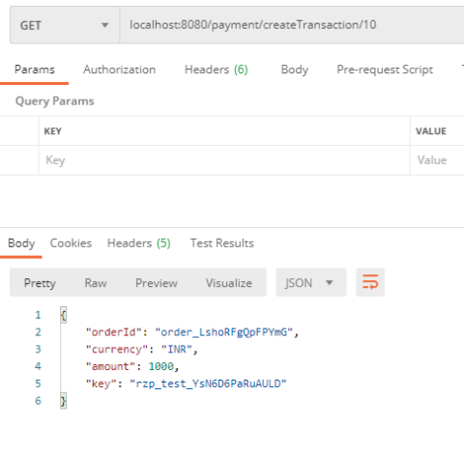
Steps to Integrate with Spring boot
Step 15 : Generate Order Id through localhost:8080/payment/createTransaction/10

Slide 20
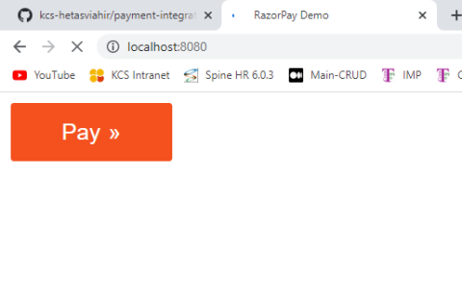
Steps to Integrate with Spring boot
Step 16 : Go to localhost:8080 in browser and click on pay button .

Slide 21
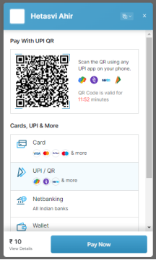
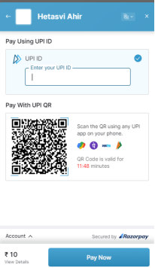
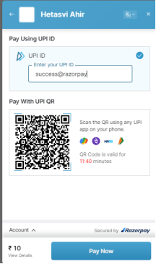
Steps to Integrate with Spring boot
Step 17 : It will redirect to razor pay
Success

Slide 22
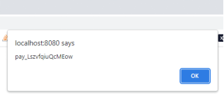
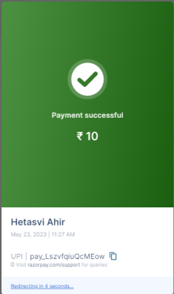
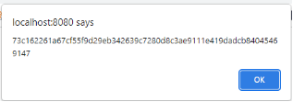
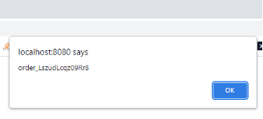
Steps to Integrate with Spring boot
Step 17 : It will redirect to razor pay
Success

Slide 23
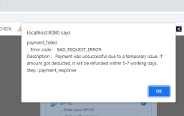
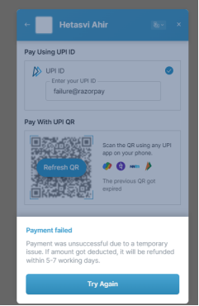
Steps to Integrate with Spring boot
Step 18 : Failure

Slide 24
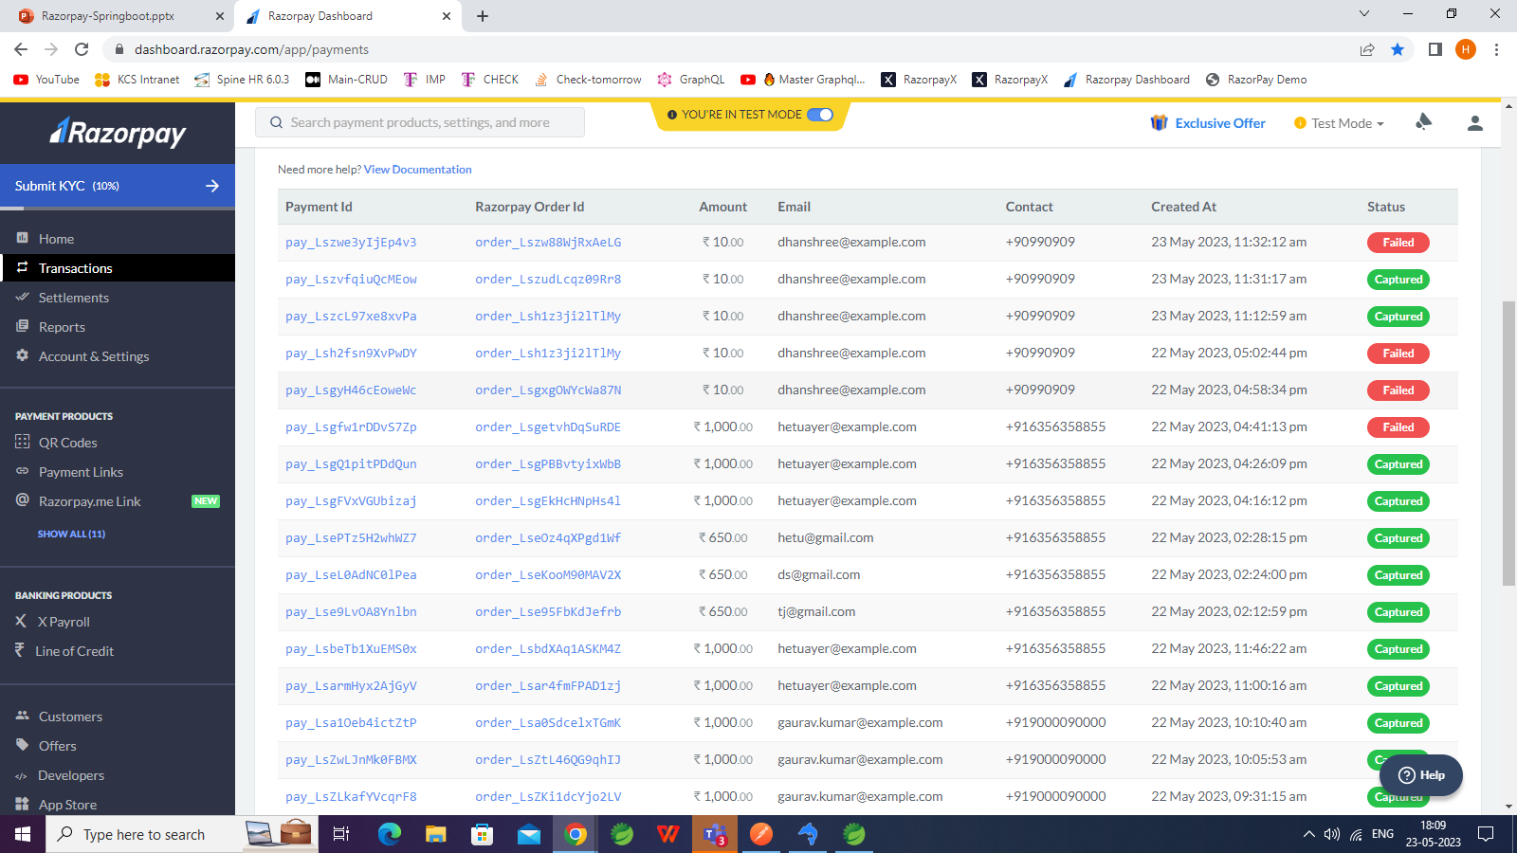
Steps to Integrate with Spring boot
Step 19 : Transactions in Dashboard

